Slide 1
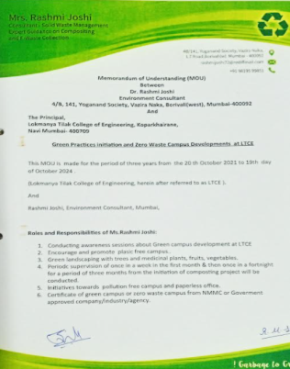
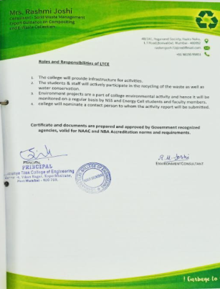
Electrical Department Achievements/ Recognitions
Consultancy-Green Initiatives-Rs.10,62,000/-
14

